Slide 1

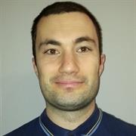

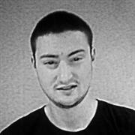
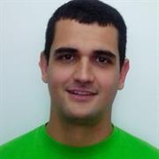
Team Griffin
Members
Lyudmil Nikodimov
Nikola Nenov
Emiliya Georgieva
Nikola Bogomirov
Plamen Paunov

Slide 2
Windows 7 Bugs - Reproduced

Slide 3
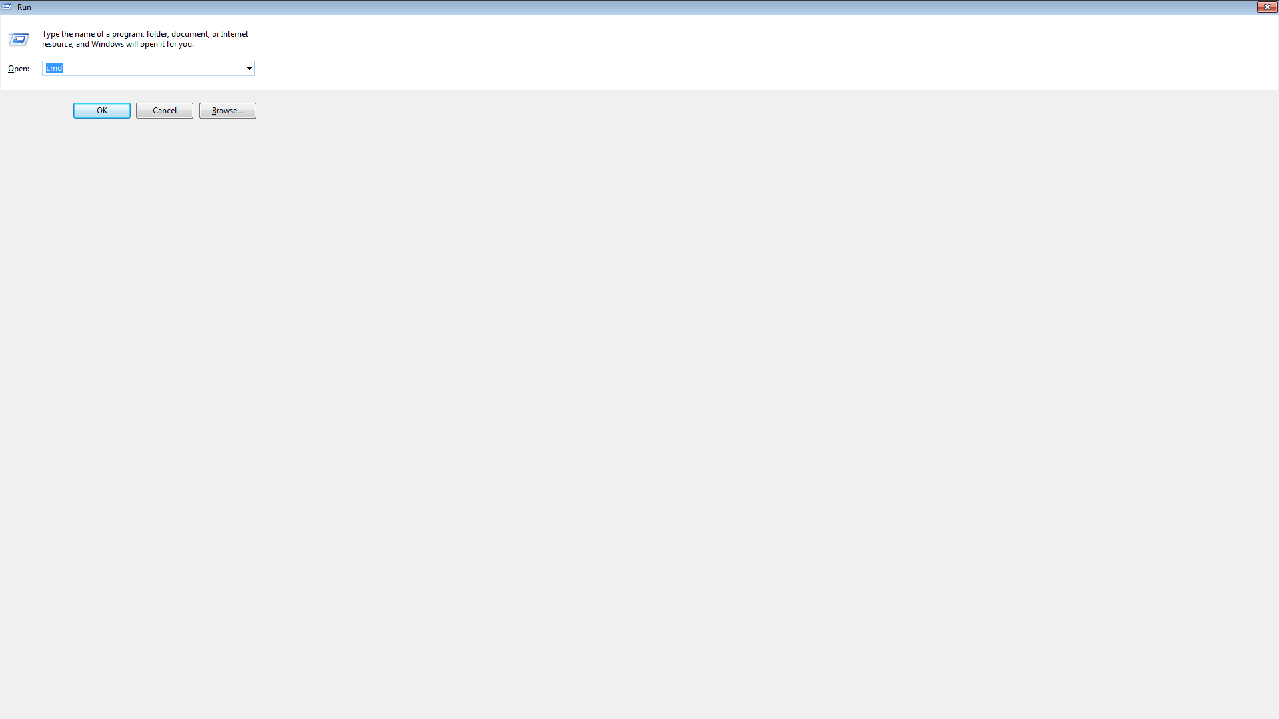
Task Manager Maximize Bug

Slide 4
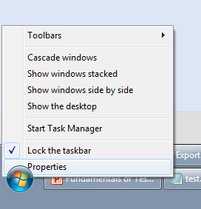
Orb or Taskbar Bug

Slide 5
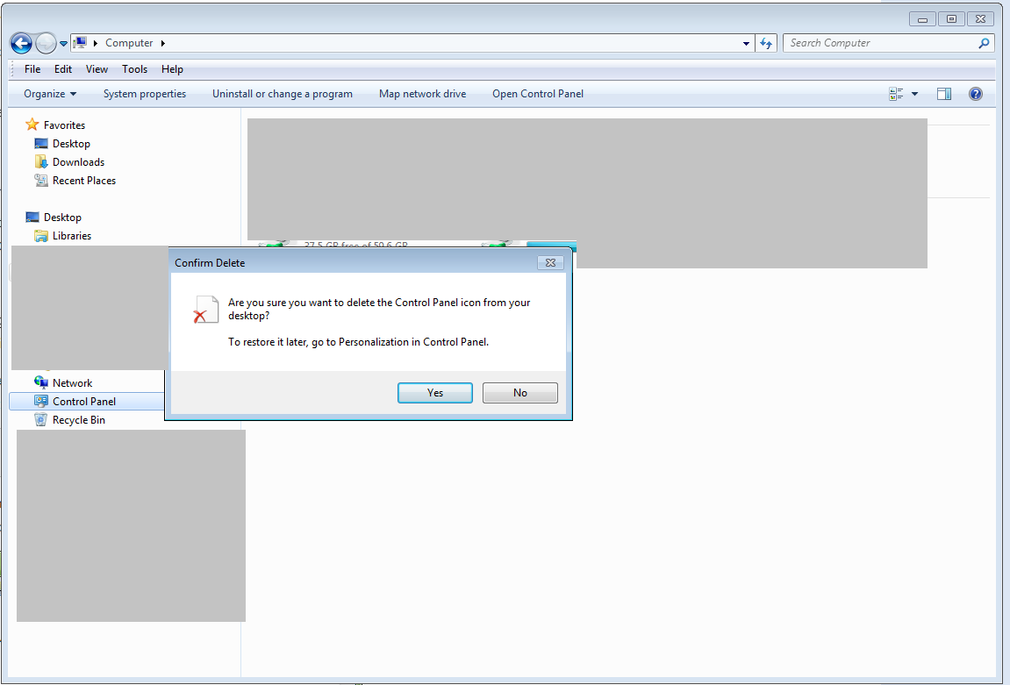
Items Reappear After Deleting From Navigation Pane

Slide 6
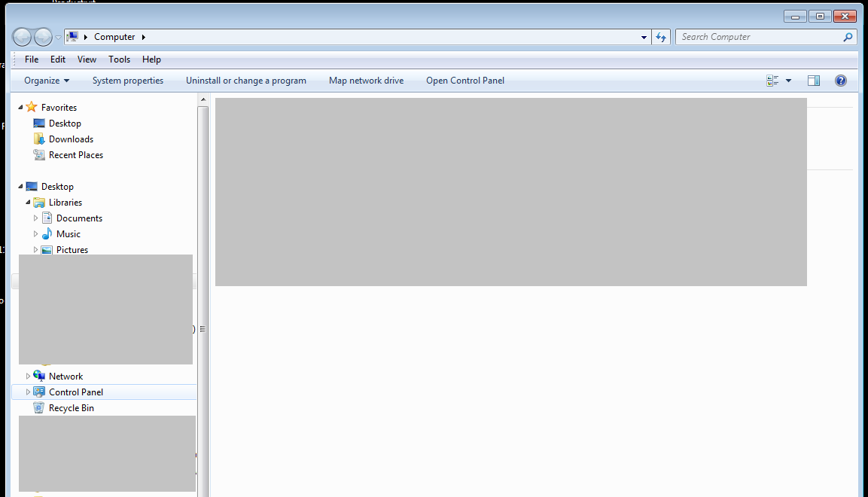
Items Reappear After Deleting From Navigation Pane

Slide 7
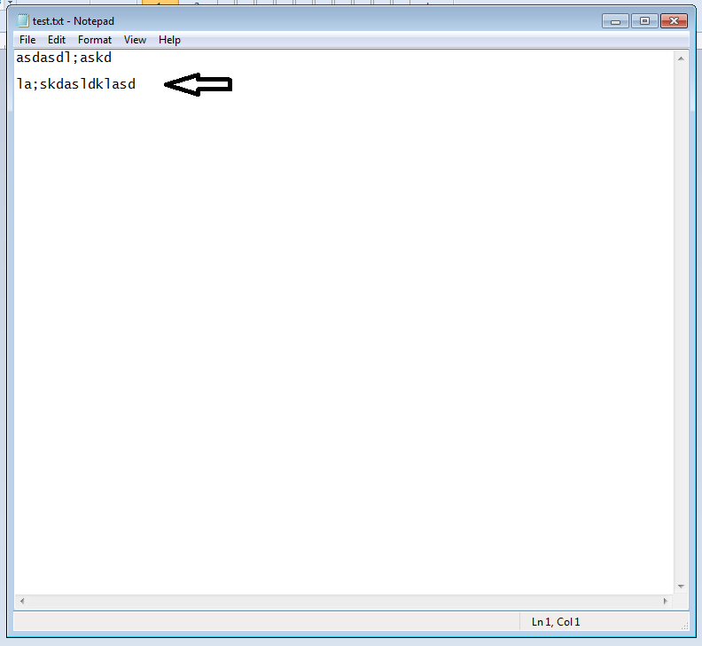
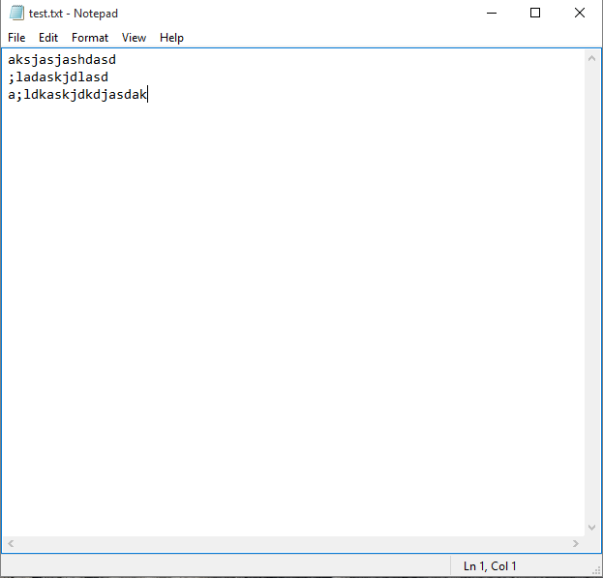
Notepad Status Bar Bug

Slide 8
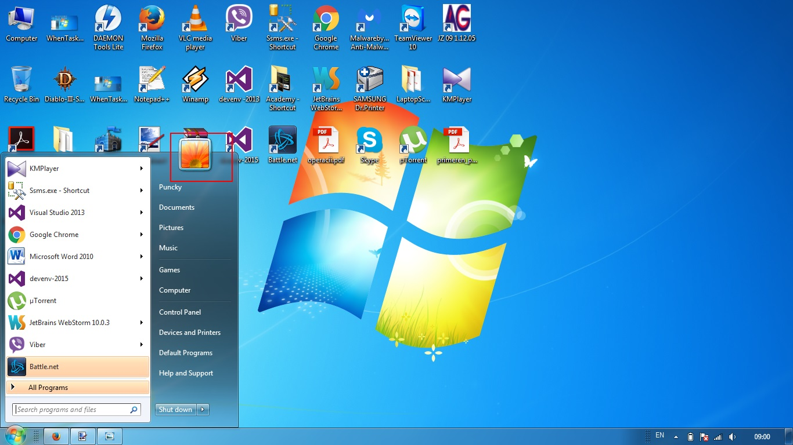
Profile Picture Disappears Bug

Slide 9
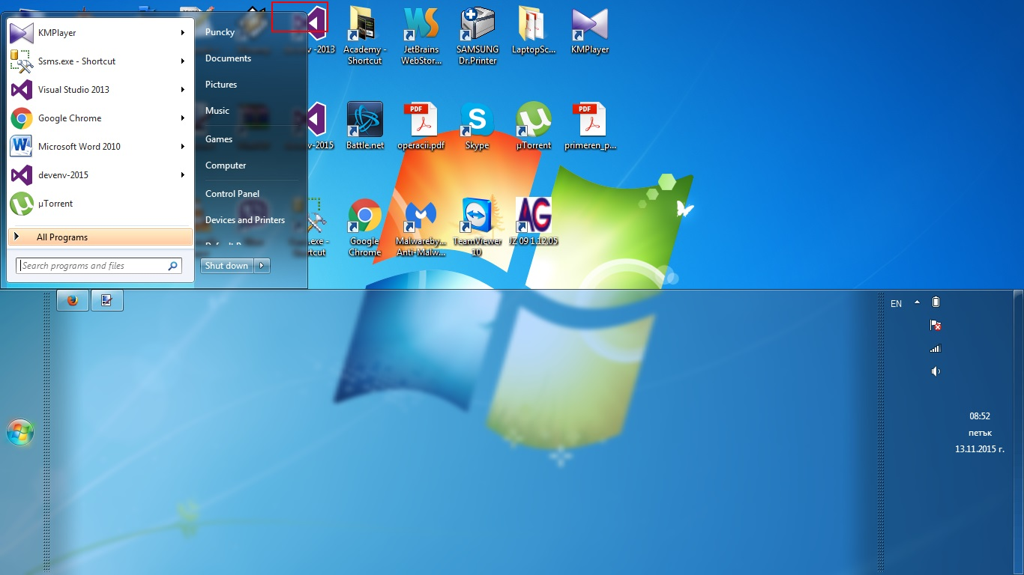
Profile Picture Disappears Bug

Slide 10
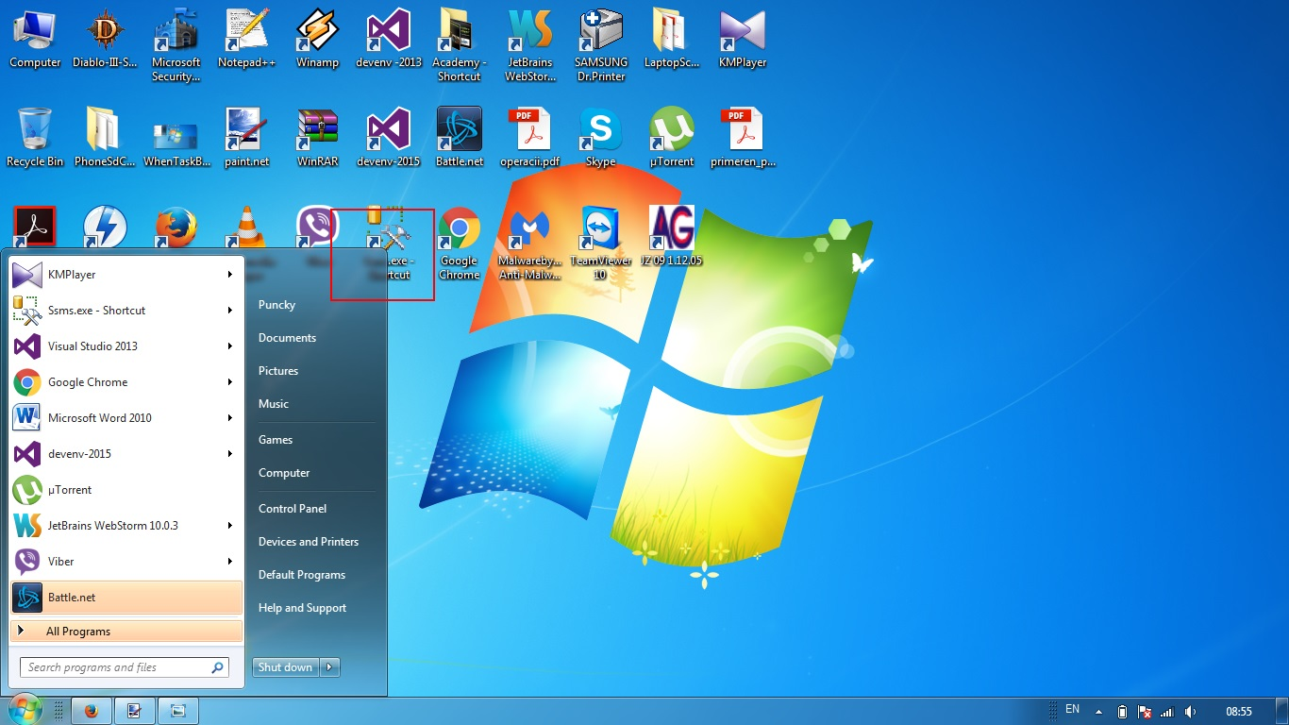
Profile Picture Disappears Bug

Slide 11
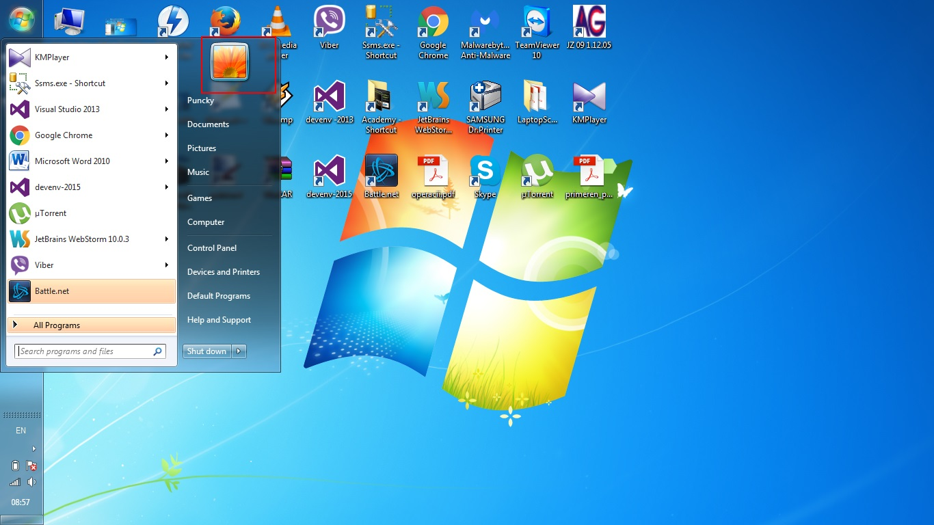
Profile Picture Disappears Bug

